Slide 1

1.2.3 The Fundamental Theorem of Calculus
Theorem: If $f\left(x\right)$ is a continuous function on $[a,b]$ and $f\left(x\right)$ is an indefinite integral of $f\left(x\right)$ then
where $∫f\left(x\right)dx=F(x)$.
Example:
1.
2.
3.

Slide 2
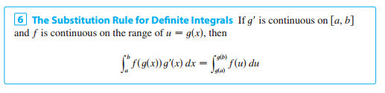
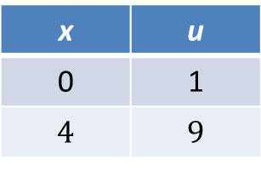
1.2.4 Substitution Rule For Definite Integrals
Example:
Changing Limit
x | u
0 | 1
$$4$$ | $$9$$

Slide 3
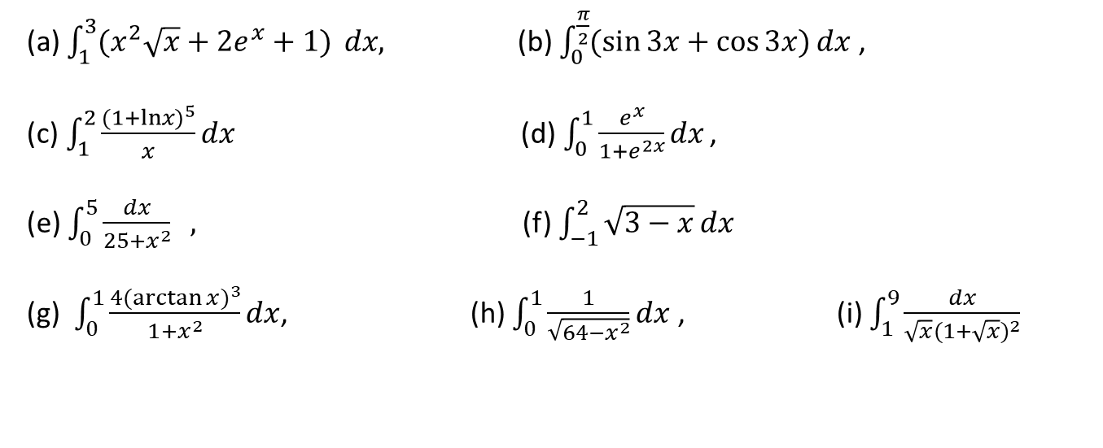
Exercise set 1.2.2
1.
(a) $\int_{1}^{3}{(x^{2}\sqrt{x}+{2e}^{x}+1)} dx,$ (b) $\int_{0}^{\frac{π}{2}}{(\sin{3x}+\cos{3x})}dx$,
(c)$\int_{1}^{2}{\frac{{(1+lnx)}^{5}}{x}}dx$(d)$\int_{0}^{1}{\frac{e^{x}}{1+e^{2x}}}dx$ ,
(e) $\int_{0}^{5}{\frac{dx}{25+x^{2}} } ,$ (f) $\int_{−1}^{2}{\sqrt{3−x}}dx$
(g) $\int_{0}^{1}{\frac{4{(\arctan{x})}^{3}}{1+x^{2}}dx}$, (h) $\int_{0}^{1}{\frac{1}{\sqrt{64−x^{2}}}dx}$ , (i) $\int_{1}^{9}{\frac{dx}{\sqrt{x}{(1+\sqrt{x})}^{2}}}$
2.
Calculus– James Stewart - 8th edition
P-400 Ex # 19, 23, 24, 25, 27, 29, 35, 43
P-409 Ex # 21 – 30
P- 419 Ex # 53, 54, 55, 59, 60, 70, 71

Slide 4
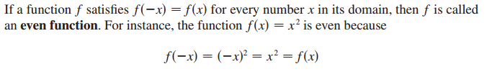

1.2.5 Even and Odd Function

Slide 5
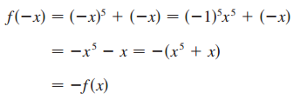


Example:
State whether the following functions are odd, even or neither.
Solution:
(a)
So, f(x) is an odd function
(b)
So, g(x) is an even function
(c)
So, h(x) is neither even nor odd function

Slide 6
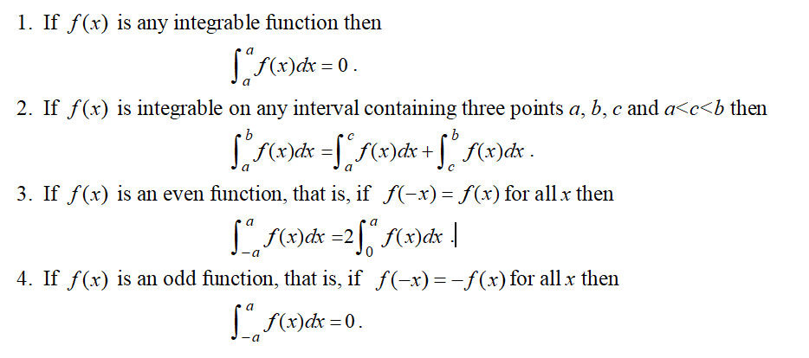
1.2.6 Some properties of definite integral

Slide 7
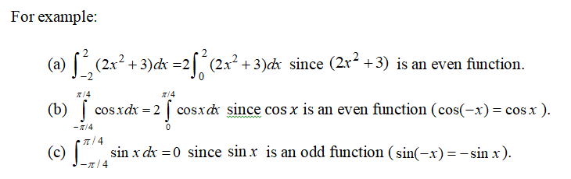

Slide 8
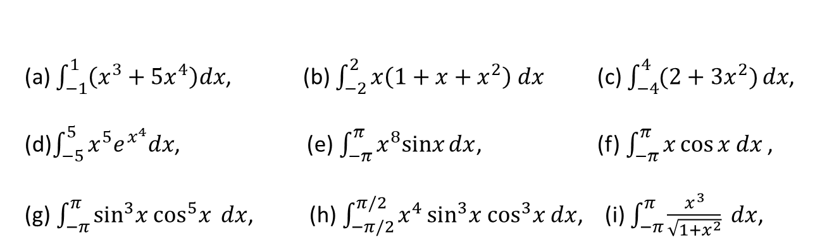
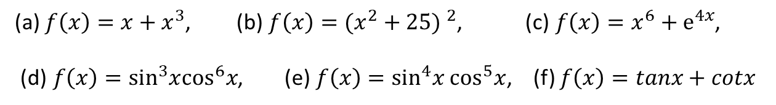
Exercise set 1.2.3
1.
State whether the following functions are odd, even or neither.
(a) $f\left(x\right)=x+x^{3}$, (b)$f\left(x\right)={(x^{2}+25) }^{2}$, (c)$f\left(x\right)=x^{6}+e^{4x}$,
(d)$f\left(x\right)=\sin^{3}x\cos^{6}x$, (e)$f\left(x\right)=\sin^{4}x\cos^{5}x$, (f) $f\left(x\right)=tanx+cotx$
2.
Evaluate the following integrals by using integral properties
(a) $\int_{−1}^{1}{\left(x^{3}+{5x}^{4}\right)dx}$, (b) $\int_{−2}^{2}{x\left(1+x+x^{2}\right) dx}$(c) $\int_{−4}^{4}{(2+{3x}^{2})}dx$,
(d)$\int_{−5}^{5}{x^{5}e^{x^{4}}dx}$, (e)$\int_{−π}^{π}{x^{8}sinx}dx$, (f)$\int_{−π}^{π}{x\cos{x dx}}$ ,
(g)$\int_{−π}^{π}{\sin^{3}x \cos^{5}x} dx$, (h)$\int_{−π/2}^{π/2}{x^{4}}\sin^{3}x \cos^{3}x dx$, (i) $\int_{−π}^{π}{\frac{x^{3}}{\sqrt{1+x^{2}}} dx}$,
3.
Calculus– James Stewart - 8th edition
P- 419 Ex # 61, 66, P-422 Ex # 22, 23

